Slide 1
SCSIT IV Semester Introduction to Databases
Lecturer: Zoran Gichevski
Domain Consultant at Avenga (Seavus)
Operations Center | Managed Services

Slide 2
Lecturer
Zoran Gichevski
Responsible for two 24/7 IT Operations and Support Teams at Operations Center | Managed Services Division.
Contact:
Email: zoran.gichevski@uacs.edu.mk
LinkedIn: https://mk.linkedin.com/in/zoran-gichevski

Slide 3
Introduction to Databases
Lecturer/Mentor: Venera Gudachi, PhD
Assistant/Collaborator: Zoran Gichevski
Schedule hours:
Group 2: Tuesday 17:00-19:00
Group 1: Thursday 17:30 – 19:30
Room: L2/2nd floor - L5 /4th floor
Consultation hours: On-Demand

Slide 4
Weekly delivery plan
Lecture 1 – 6
Mid Term Exam
Lecture 7 – 12
Reading week
Final Exam
MakeUp Exam

Slide 5
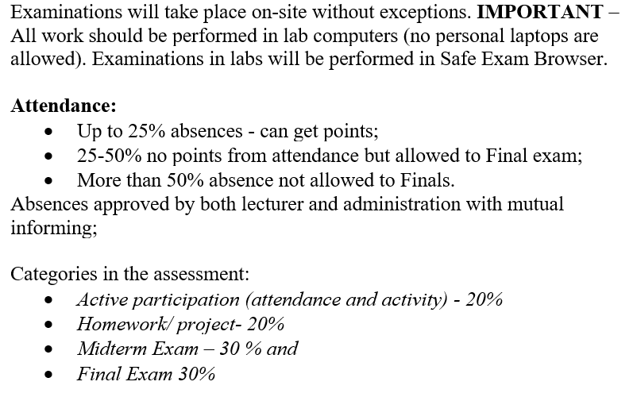
Evaluation structure and assessments during teaching semester

Slide 6
Evaluation structure and assessments during teaching semester
Categories in the assessment:
Active participation (attendance and activity) – 20%
Homework/project – 20%
Midterm Exam – 30%
Final Exam – 30%
Each category in the assessment is equally distributed between theoretical and practical part, i.e., each 50%. To be able to pass the exam in each category in the assessment there is a need to obtain at least 20% both in theoretical and practical part. Additionally, the distribution of points for theoretical and practical part will be equally distributed in active participation and homework/project as well.

Slide 7
Evaluation structure and assessments for MakeUp examinations
Examination Instructions and Assessment Details:
Examinations will be conducted on-site only, with no exceptions.
Exams must be completed on lab computers using the Safe Exam Browser.
Personal laptops during exams are not allowed.
Assessment Categories:
Theoretical part – 50%
Practical part – 50%
Exam Duration:
Maximum: 2 hours 30 minutes
Theoretical part: 60 minutes
Practical part: 90 minutes
Exam Content:
Theoretical section: multiple-choice questions, true/false questions, and a critical response essay.
Practical section: exercises taught during classes.

Slide 8
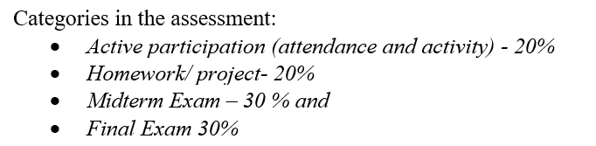
Evaluation structure and assessments during teaching semester
Attendance: 10% from Practical part
Attendance: 5%
Activity/Participation: 5%
Homework: 10% from Practical part
Delivery 7 days after the class on e-mail
Mid Term Exam: 15% from Practical part
Final exam : 15% from Practical part

Slide 9
Used programs during semester
Diagram.net (draw.io)
Microsoft SQL Server
DB Engine: MS SQL Server 2019 Express Edition https://www.microsoft.com/en-us/download/details.aspx?id=101064
SQL Management Studio (SSMS) 18.12 https://learn.microsoft.com/en-us/sql/ssms/download-sql-server-management-studio-ssms?view=sql-server-ver16

Slide 10
Classes learning flow
Learning materials will be on Moodle
Presentation – available after the classes
Exercises – available after the classes
Homework – after the classes
Deadline 7 days after publishing
Additional info or materials
Upon request on Moodle

Slide 11
Questions ?

